Slide 1



OPTIMIZING THE STOCKS OF
STATIONERY FIRM
PRESENTATION BY
GAGNEET KAUR
ROLL NO. 21F1006856

Slide 2
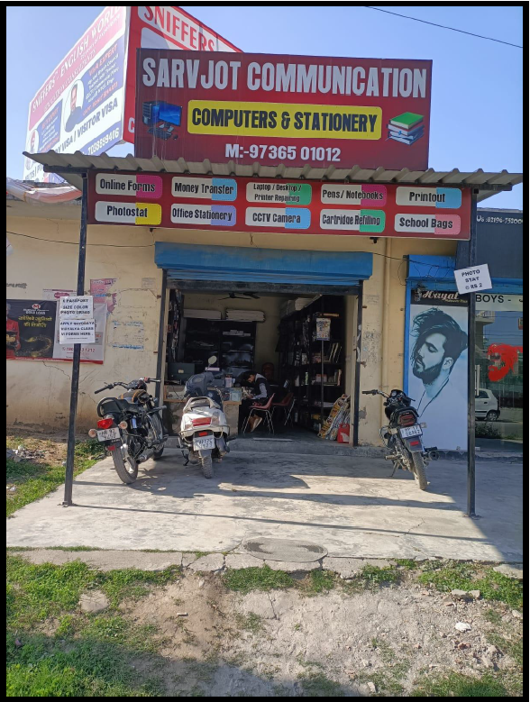



ABOUT THE PROJECT
A stationery firm namely 'Sarvjot Communications' was chosen for the data analysis purpose. 12-week data was collected, processed and analyzed.
Objective of the project was to identify the business problems and find a way out to solve those problems to help the shop owner run the business in a better way.
PROBLEM STATEMENTS
1
2
3
1
2
3
problem of reaching a large customer base.
facing problems in analyzing time-based stocks leading to overstocking or stock outs at different times
generation of less revenue by the organization

Slide 3




PROBLEM SOLVING APPROACH
Reaching a large customer base :
Survey school and college students regarding their stationery needs
Advertising the products through different media channels
Analyzing time-based Stocks :
Check the annual calendars of colleges and schools to stock-in the relative items accordingly
Making a proper timeline for the firm by analyzing the schools and colleges calendars
Collecting and analyzing data
Generation of Revenue
Diversifying products: The owner can consider adding new products to the inventory to attract new customers and generate more revenue.
Adding more services: Since the owner is skilled with hardware engineering, he can add the services such as computer repairing and printer repairing so as to increase revenue without investing any kind of capital.

Slide 4
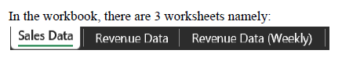
DATA COLLECTED
Time Period of Data Collected : 12-weeks (December 2022 to February 2023)
Sales Data : This sheet holds the data of all the items of the shop, their rate and weekly sale
of each item.
Revenue Data : This sheet holds the revenue data across all the three months date-wise
Revenue Data (Weekly) : This sheet holds the revenue data generated weekly

Slide 5

ANALYSIS PROCESS
Collection of annual calendars of schools and colleges in the town
Pre-processing :
Data entered manually
Paste-Transpose function used
Various formulas used to easily enter data and to get weekly data of revenue sheet
Descriptive Analysis
With the help of Excel, different formulas could be used to get the Summary Statistics of the data
The descriptive statistics were calculated using Excel formulas like MAX, MIN and SUM.
Further to understand the data precisely and easily, pictorial representations were used.
Diagnostic Analysis
The trends across the weeks were very helpful along with the school and college annual calendars.
The weekly total sale chart came in handy to check which time of the month saw the most and least sales and the annual calendars helped to identify why such problems occurred.

Slide 6
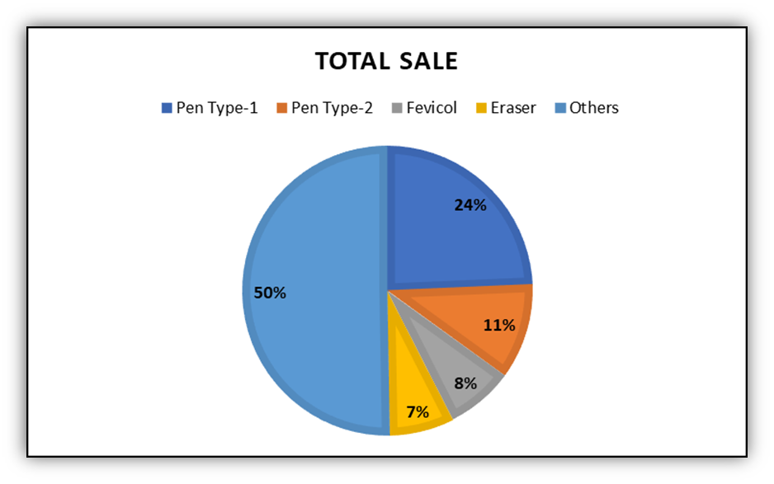
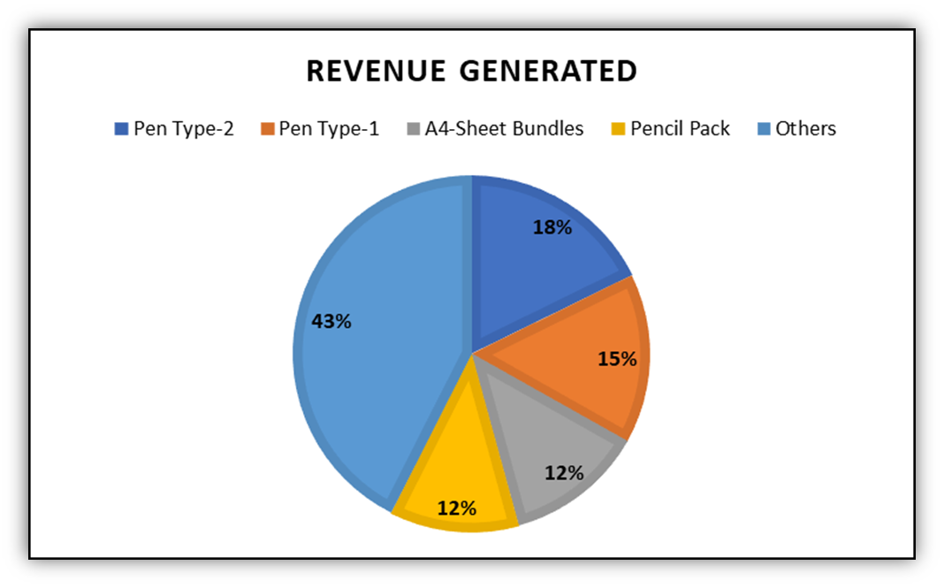
RESULTS
On the basis of sales and revenue, the best 4 products were filtered out.
From both the charts it can be concluded that ‘PEN TYPE-1’ and ‘PEN TYPE-2’
dominate the overall sales and revenue generation of the shop.

Slide 7
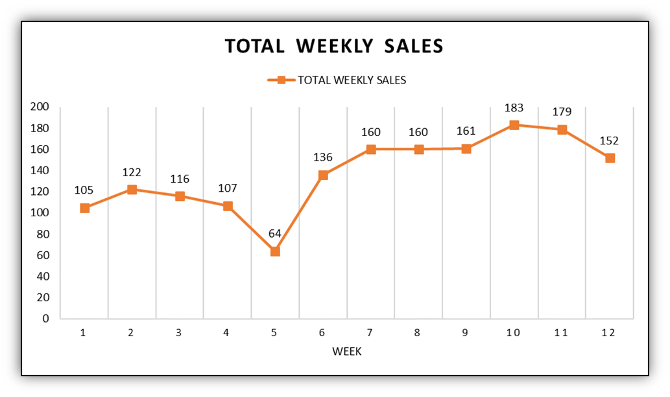
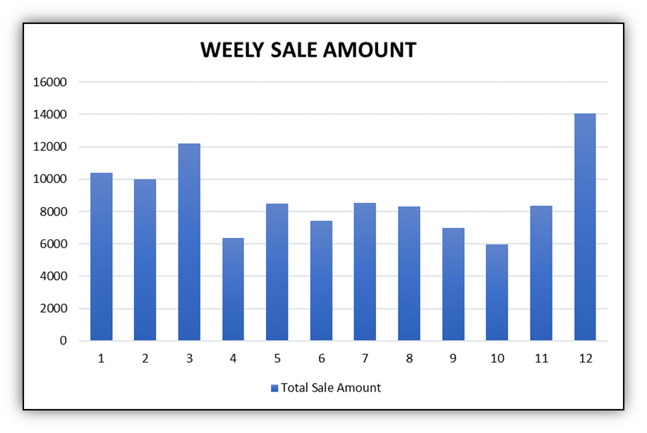
RESULTS
Weekly Sales of all products altogether
Weekly Revenue of all products altogether

Slide 8
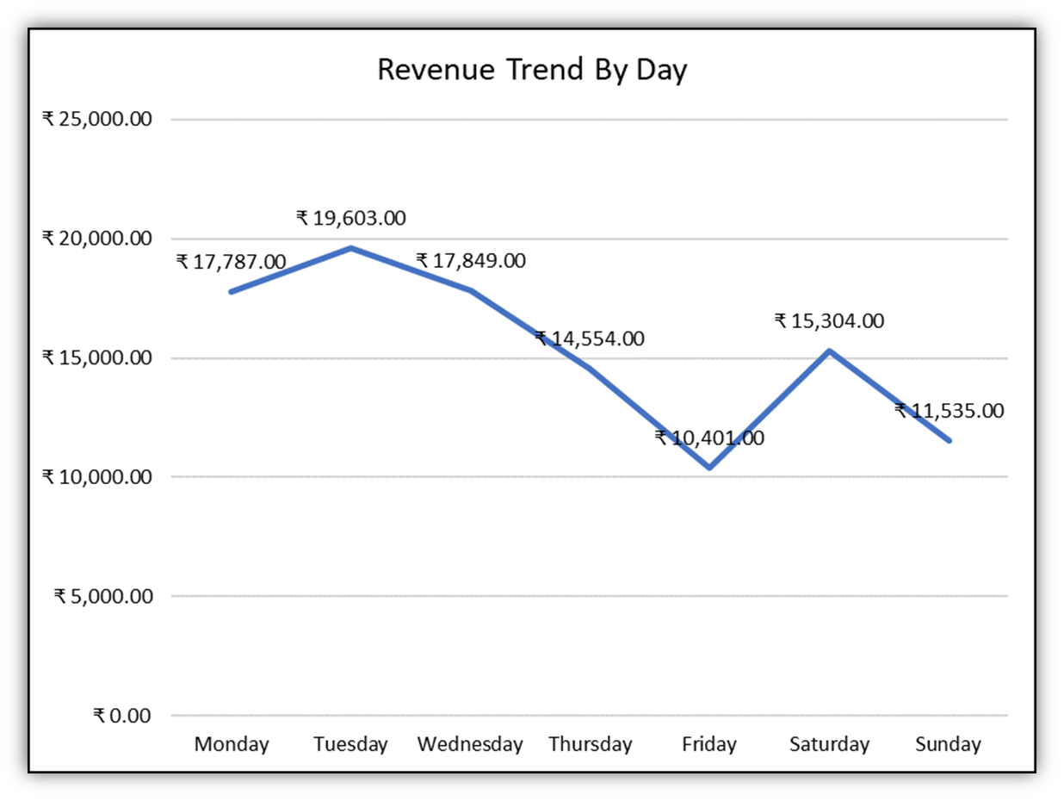
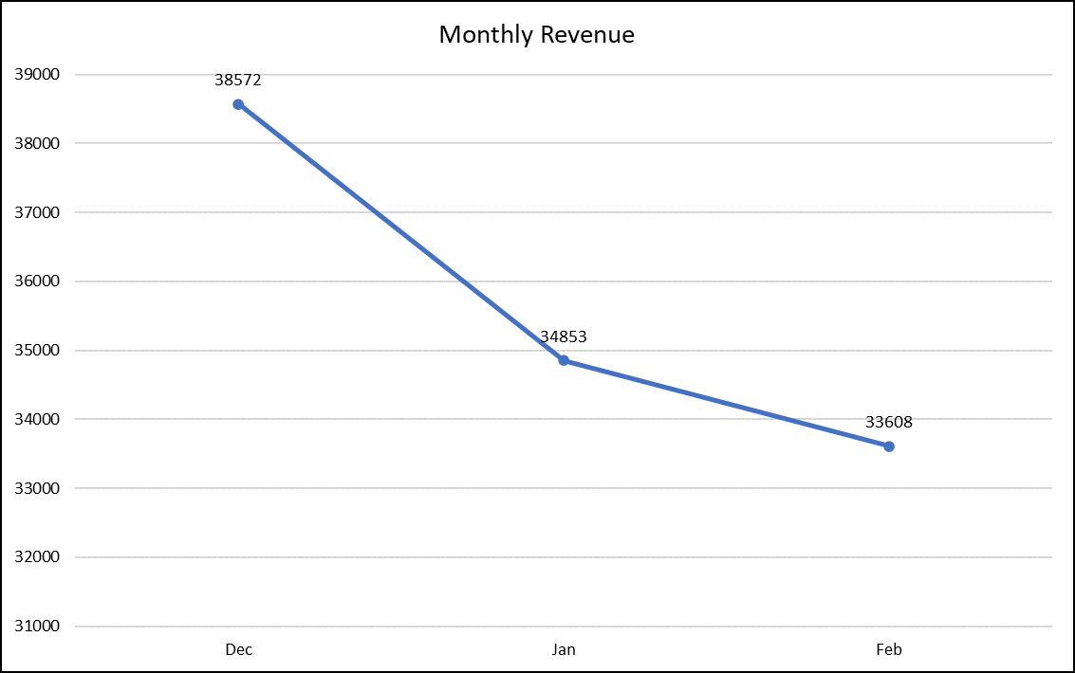
RESULTS
Beginning of the week is highly profitable whereas
weekends face a dip in the revenue generation process.
There has been a decrease in the amount of revenue generated across the three months span.

Slide 9
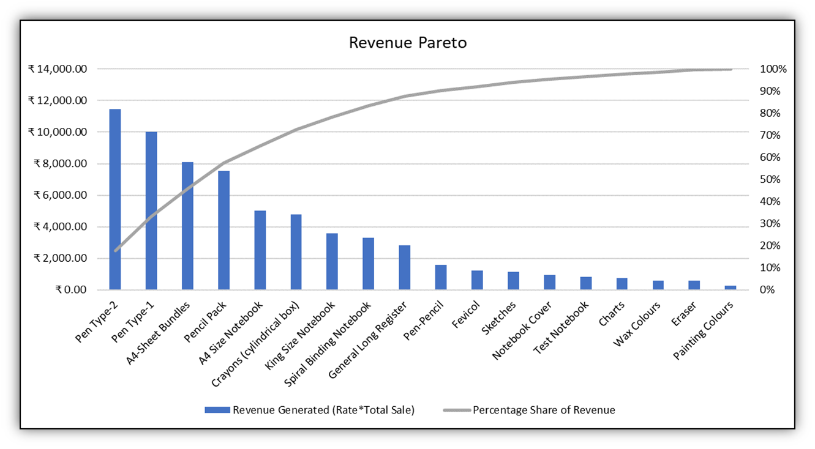
RESULTS
It is observed that 20% of the items generated 60% of the revenue for the shop.
Somehow this observation could also be put to use for better stock-ins of the firm.
Whereas it can be noticed that 80% of the revenue generation comes from 45% of the products sales.

Slide 10




RECOMMENDATIONS
Try to keep the shop open on weekends for longer hours to cater to the students who might not prefer
buying their stationery needs while going to school rather on holidays.
Since ‘PEN TYPE 2’ contributed the most to the revenue generated in 3 months, it would be
beneficial to promote this product more and make it easily accessible to the customers.
Increase the inventory of ‘PEN TYPE 1’
as it is the most sold product.
STRATEGY N°1
STRATEGY N°2
STRATEGY N°3

Slide 11
RECOMMENDATIONS
Plan marketing campaigns and offer discounts during the period of February and March to attract
more customers and increase revenue. This can be done by bundling cheaper items such as ‘Test
Notebooks’, ‘Pens’ and ‘Pencils’ with the purchase of other products.
Focus on the top-4 products of the shop as they generate more than half of the revenue. Make
sure that the inventory of these products is always well-stocked to avoid running out of stock
during peak sales periods
To avoid the dip in the revenue which was observed from December to January, adjustments
need to be made in the inventory or marketing strategies accordingly to prevent further losses
during these periods.
STRATEGY N°4
STRATEGY N°5
STRATEGY N°6

Slide 12

THANK YOU

